Slide 1

Database Management System Course-code: CSE 313
Prepared By:
Sumaia Rahman
Lecturer, Dept. of CSE,
Varendra University

Slide 2
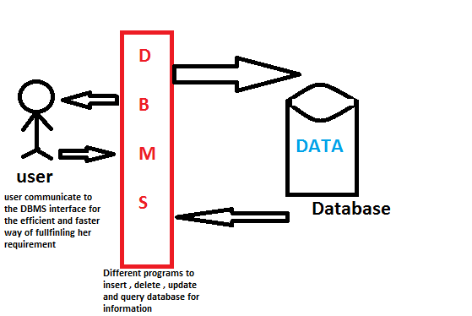
What is Database? A database is a collection of information that is organized so that it can be easily accessed, managed and updated. Most commonly used databases are Oracle 12c(enterprise database), MySQL (mostly used for web based application), MongoDB (Non RDBMS), MariaDB (is a fast RDBMS) and so on. What is DBMS? A database management system (DBMS) is system software for creating and managing databases. DBMS provides an API between the database and user.

Slide 3
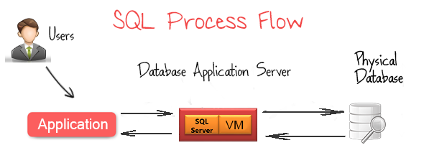
What is SQL? SQL stands for Structured Query Language which is a very powerful and diverse database language use to storing, manipulating and retrieving data into databases. SQL is a greater tool with web languages such as PHP, Python, Java, ASP et cetera to build dynamic web applications. Types of SQL Statement 1. DML (Data Manipulation Language) → Select, insert, update, delete etc. 2. DDL (Data Definition Language) →create, alter, drop, truncate, rename etc. 3. DCL (Data Control Language) → comment etc.

Slide 4
Create Table Construct create table tableName (columnName datatype, columnName dataType) Example: create table branch (branch_name char(15), branch_city char(30), assets integer)

Slide 5
Integrity Constraints on Tables
1. not null 2. primary key (A₁, ..., A_{n} )
Example: Declare branch_name as the primary key for branch table
.
create table branch (branch_name char(15) not null, branch_city char(30), assets integer, primary key (branch_name))
Not null is must be written if you want to make branch_name primary key
If you forget to add a Primary Key then you can follow this query after creating the table:
Alter table branch
Add Primary key (branch_name);

Slide 6

Basic Insertion and Deletion of Tuples
Newly created table is empty
Add a new tuple to branch table
insert into branch Values ('Zeropoint','Rajshahi',10000);
Delete all tuples from branch table
delete from branch
Note: Will see later how to delete selected tuples

Slide 7


Drop and Alter Table Constructs
The drop table command deletes all information about the dropped relation from the database.
drop table branch;
The alter table command is used to add attributes to an existing relation:
Alter table TableName Add ColumName DataType;
Alter table branch Add branch_id int;
The alter table command can also be used to drop attributes of a relation:
alter table tableName drop column columnName
alter table branch drop column branch_id;

Slide 8
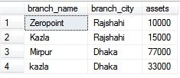
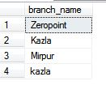

The select Clause
The select clause list the attributes desired in the result of a query
Example: find the names of all branches in the branch relation:
Select branch_name from branch
To force the elimination of duplicates, insert the keyword distinct after select.
Find the names of all branches in the branch relations, and remove duplicates
select distinct branch_name from branch
The keyword all specifies that duplicates not be removed
select all branch_name from branch;

Slide 9
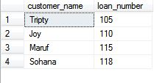
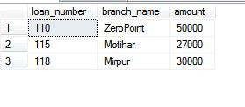

The select Clause (cont.)
The select clause can contain arithmetic expressions involving the operation, +, –, ∗, and /, and operating on constants or attributes of tuples.
select branch_name, branch_city, assets*100
from branch
Suppose you have two tables like →
Find the customer name, loan number and loan amount of all customers.
select customer_name, borrower.loan_number,loan.amount
from borrower,loan
where borrower.loan_number=loan.loan_number;
Borrower loan

